Slide 1


NRL
Air to Water
Heat Pump
Chillers and Heat Recovery

Slide 2
NRL Heat Pump

Slide 3
Section 1a:
NRL Heat Pump Features

Slide 4
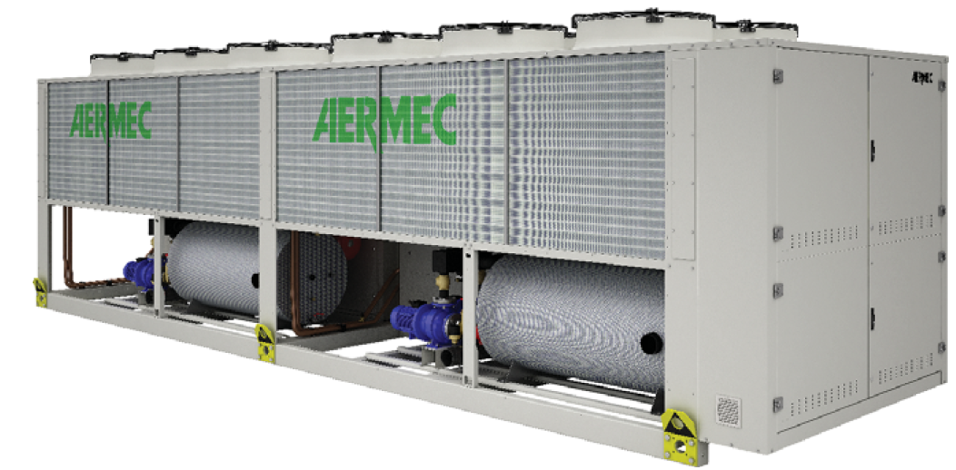
NRL Heat Pump
25 sizes range from 166,000 to 3,400,000 BTU/H (13 to 260 Tons)
Pump and buffer tank options available
Intelligent defrost
131°F hot water output
COP up to 3.03 W/W in heating mode
Minimum of 2 refrigerant circuits in a single unit
2-pipe configuration for seasonal changeover
2 independent refrigeration circuits
Optimized in heating mode
Optional desuperheater
Optional hydronic kits
Inteligent defrost

Slide 5
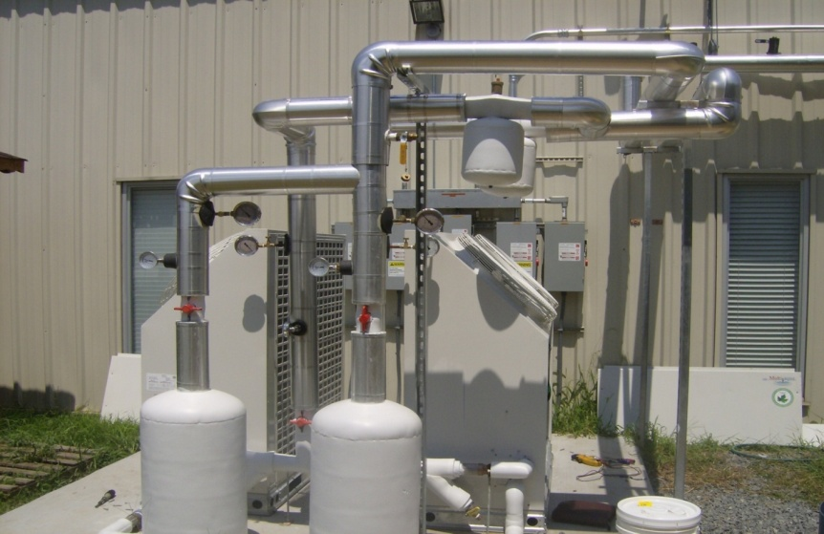
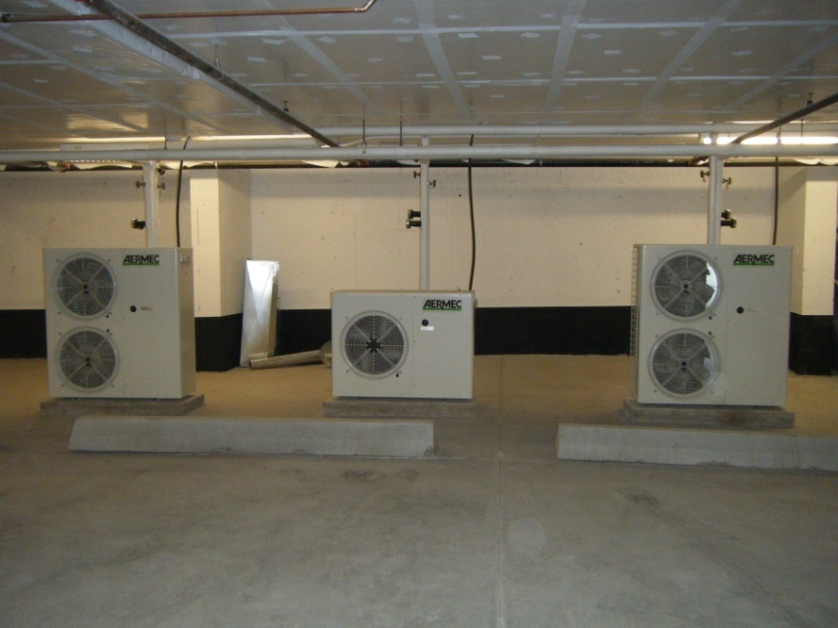



Advantages
Competitor
Aermec
The Aermec Advantage: Self contained units
Notes:
6/25/2009
‹#›
6/25/2009
‹#›
6/25/2009
‹#›
6/25/2009
‹#›
4

Slide 6
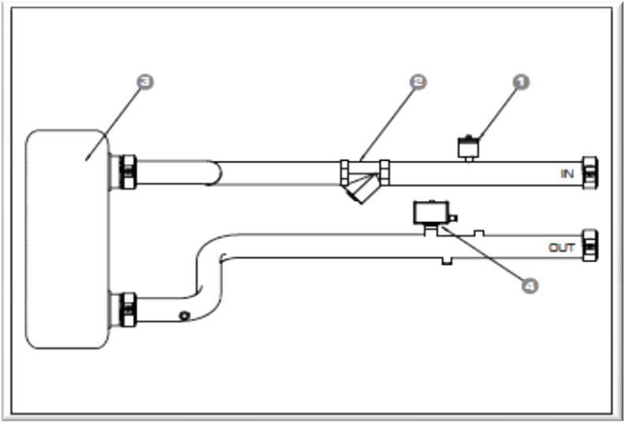
Hydronic Option
Inlet and outlet transducers
Evaporator
Evaporator
Strainer
Air vent valve
Water filter
Flow Switch
Flow switch
All NRL units will come standard with strainers, Inlet and outlet transducers and a flow switch

Slide 7
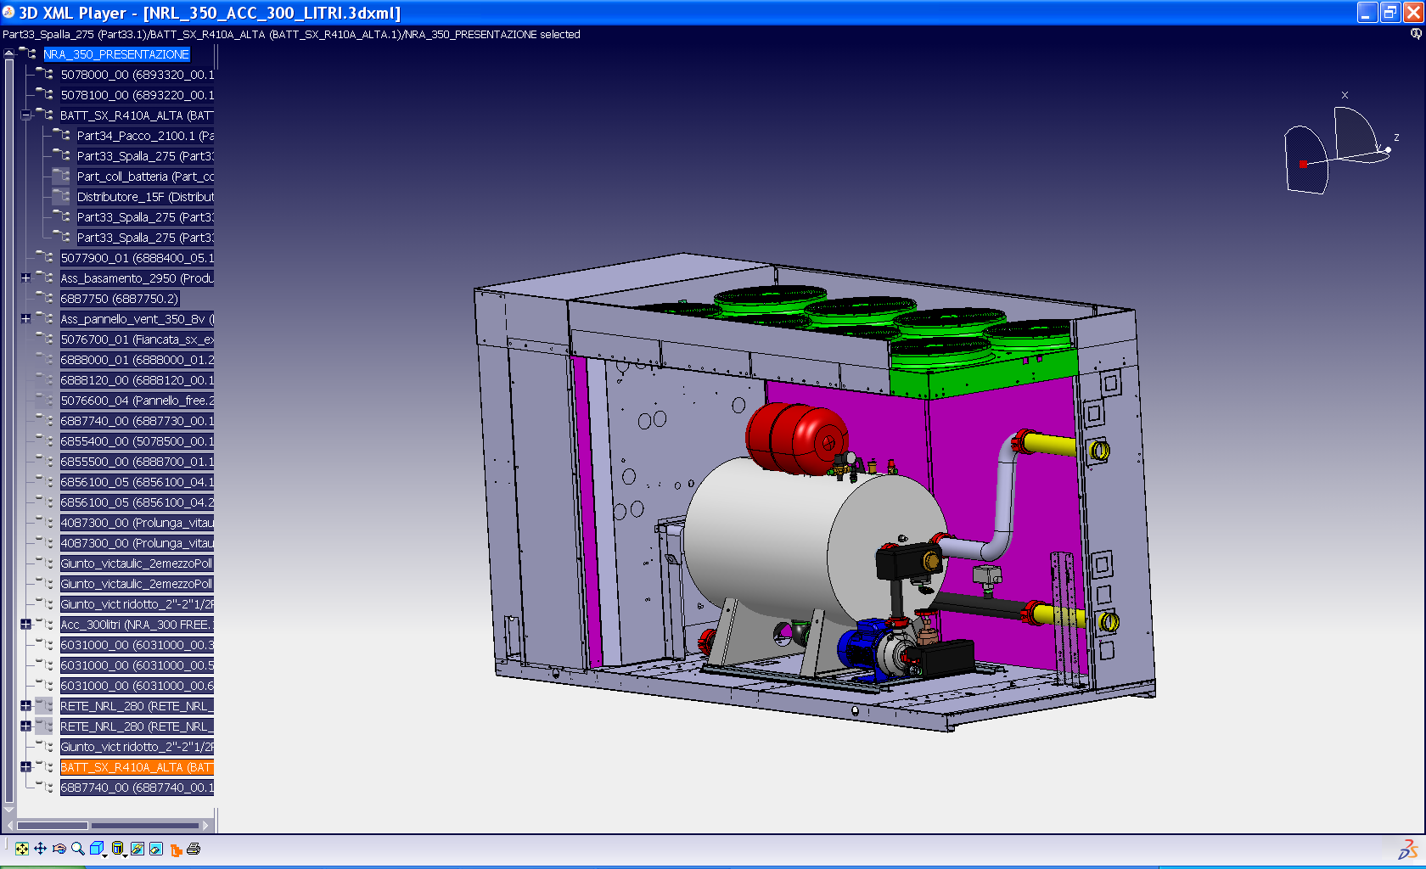
Hydraulic Options
Hydronic KIT:
00 – Without
01 – Tank and low head pump
02 – Tanks and low head pump and standby pump
03 – Tank and high head pump
04 – Tanks and high head pump and standby pump
P1 – Pump low head
P2 – Low head pump and standby pump
P3 – Pump high head
P4 - Pump and high head pump and standby pump
NRL Multiscroll with R410A

Slide 8
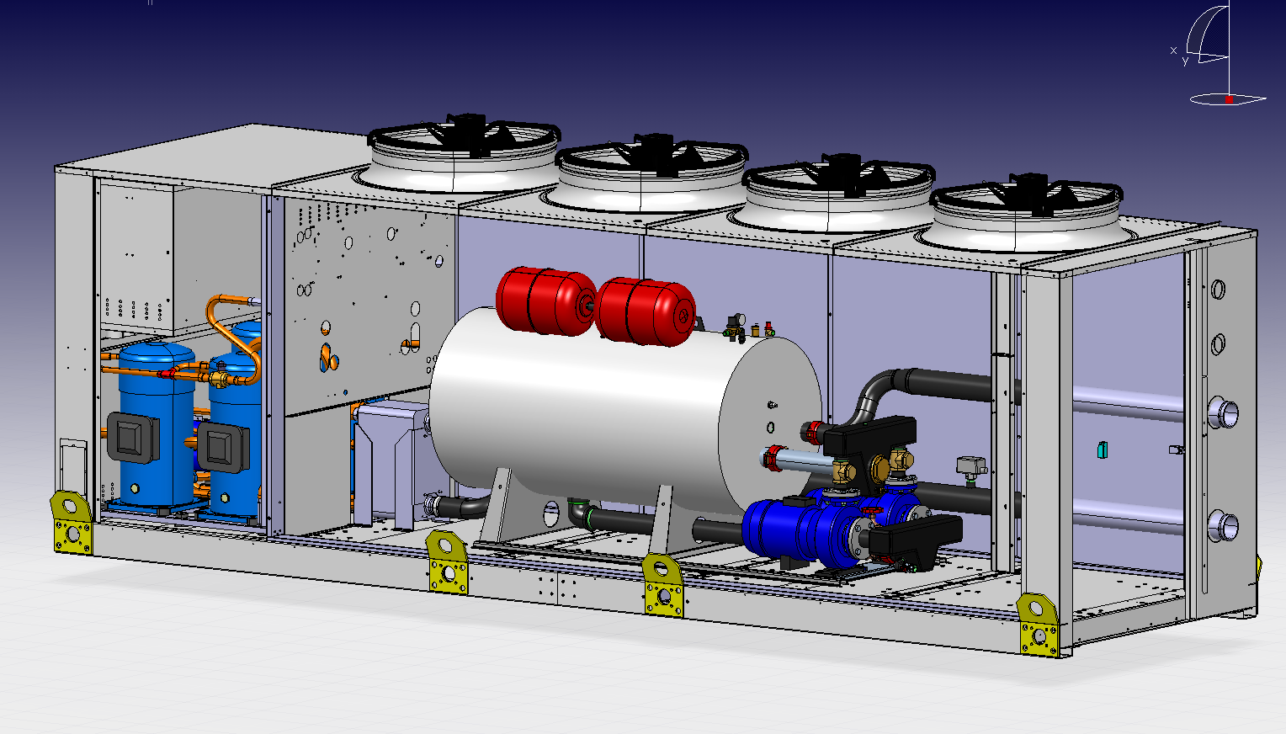
Hydraulic Options
NRL Multiscroll with R410A

Slide 9
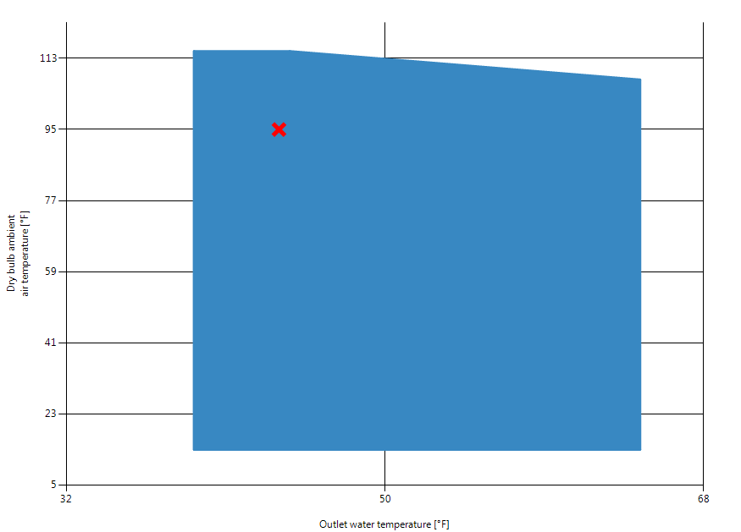
NRL Heat Pump
Operating Limits Cooling

Slide 10
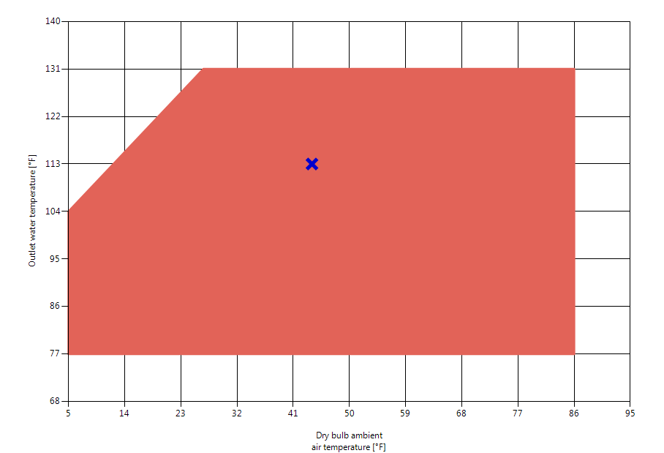
NRL Heat Pump
Operating Limits Heating

Slide 11
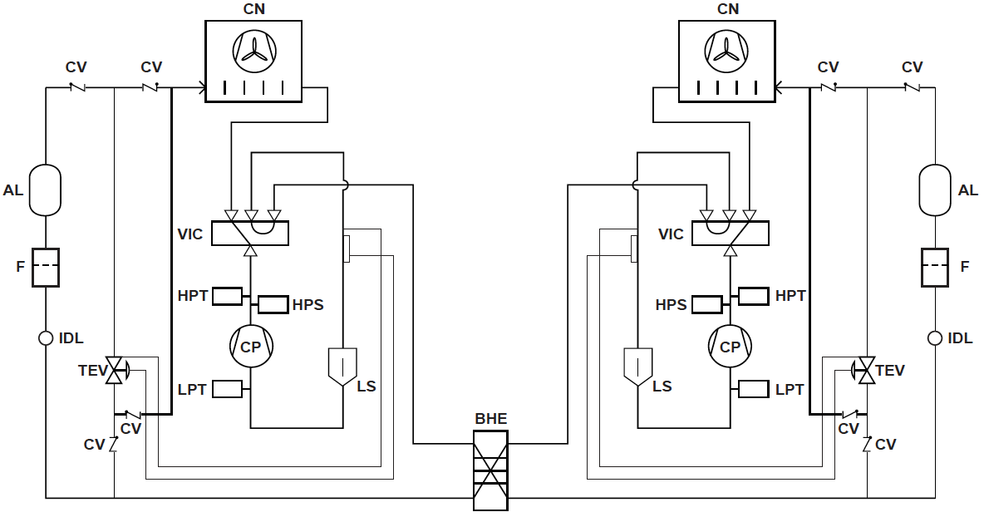
NRL Redundancy
NRL Multiscroll with R410A

Slide 12
Section 1b:
Defrost

Slide 13
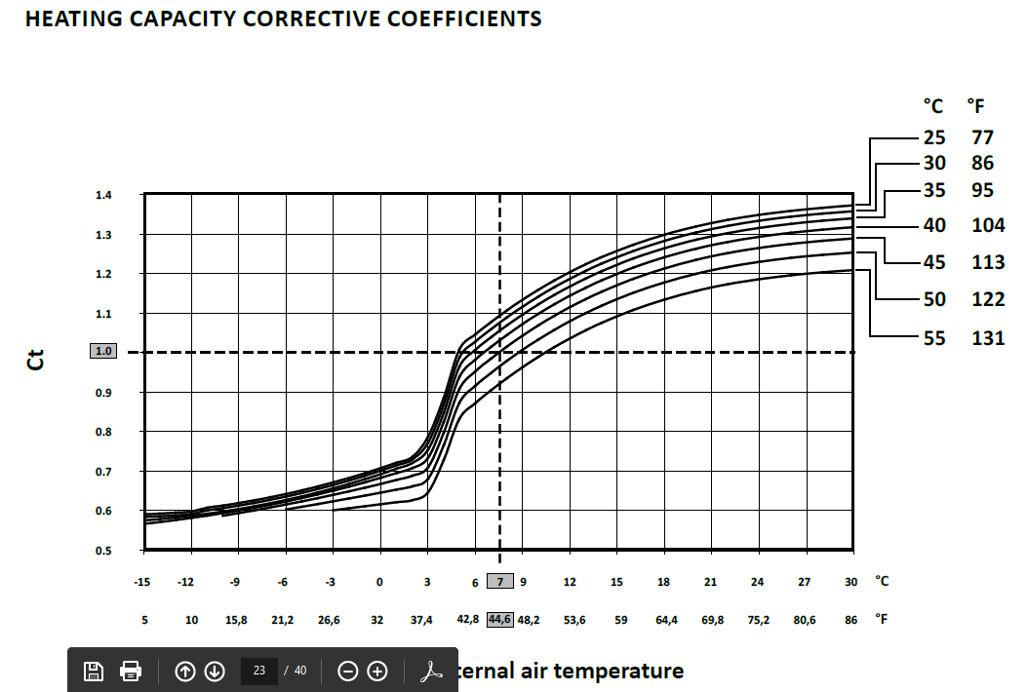
Defrosting Heat Pumps
Aermec declares all defrost penalties in our certifications as it is a requirement in Europe. Competitors in North America do not as there the air to water heat pumps sold here are actually only certified as chillers
This chart shows the penalty that is paid between the temperatures of 31˚F 38˚F or the defrost zone. As you can see there would be a fair difference in efficiencies of units that do not declare defrost

Slide 14
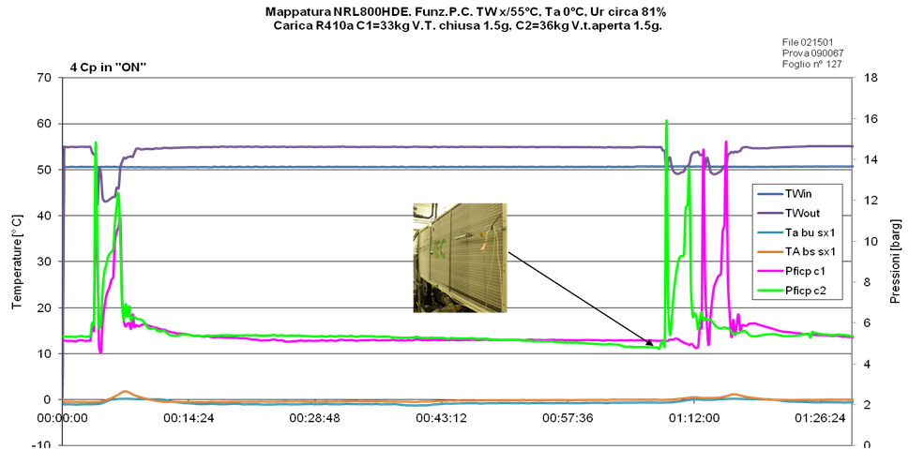
NRL Heat Pumps Intelligent Defrost
Defrost
Defrost
Pressure decrease
The intelligence is to start the defrost cycle at the right time Not too early (loss of efficiency) nor too late
The defrost operation starts when there is a decrease in pressure on the evaporator side which is a clear indication of ice production on the coils

Slide 15
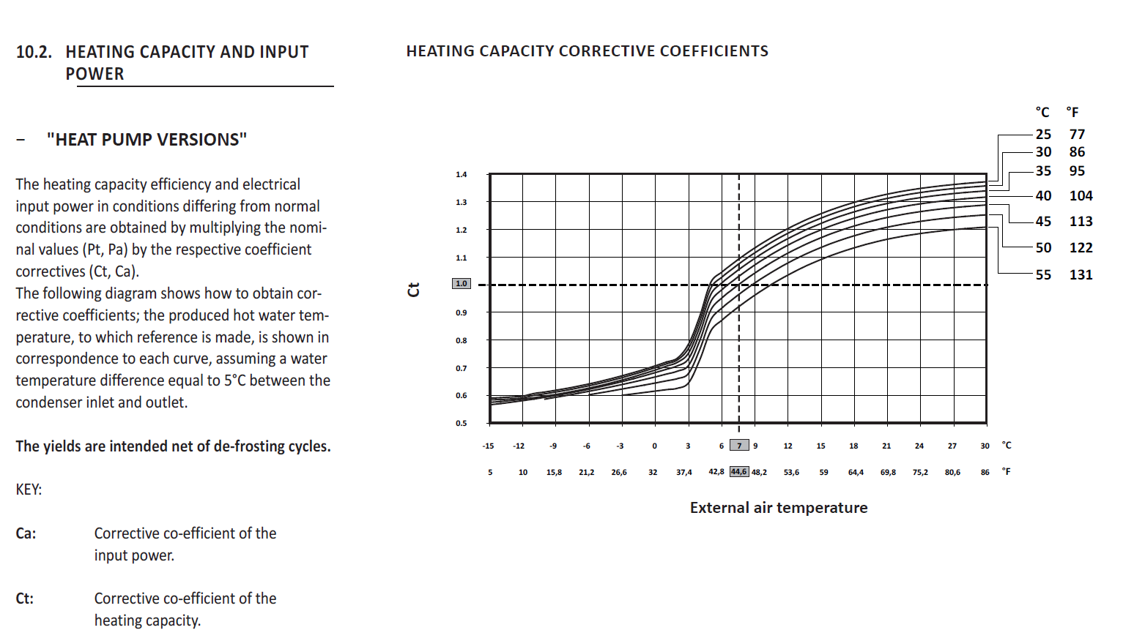
NRL Heat Pumps Intelligent Defrost

Slide 16
NRL Heat Pumps Intelligent Defrost
Aermec includes a derate for defrost in the selections
 | Heating capacity 113/104F
 | [btu/h]
Nominal - 44.6 F | 885,690.00
EN14511:2013 - 35F | 605,781.00
35F, no defrost | 750,335.00
Defrost penalty at 35F = 19.3%

Slide 17
Section 1c:
Case Studies

Slide 18


Case Studies
Apple Spaceship California
Two NRL0550°H°A°I704 Aermec heat pumps provide the hot water needed for the restaurants

Slide 19
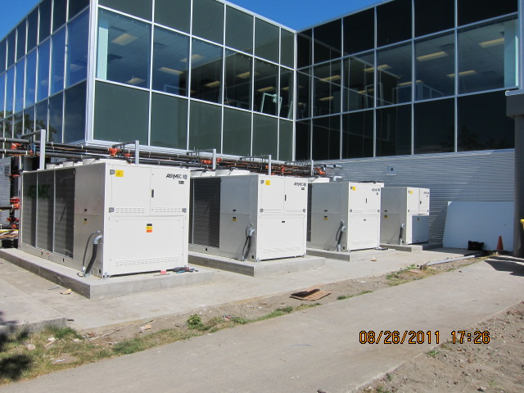
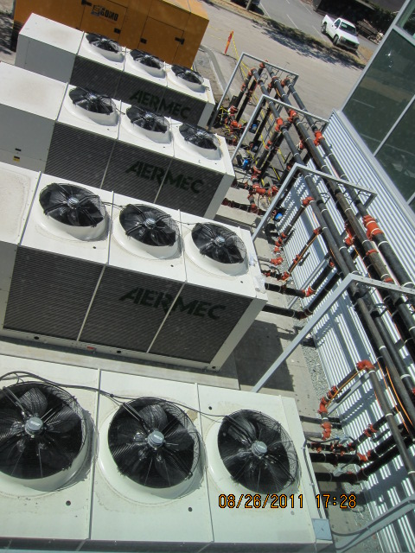
Case Studies
Head Quarters Surrey BC
4 NRL Heat Pump RCMP
Installed 2011
Notice the heat recovery piping

Slide 20
NRL Chillers &
Heat Recovery

Slide 21
Section 2a:
NRL Chillers & Heat Recovery Features

Slide 22
NRL: Heat Recovery Chillers
Optional buffer tank and pumps
Low head or high head
Single pump or redundant pumps
VFD or constant speed

Slide 23
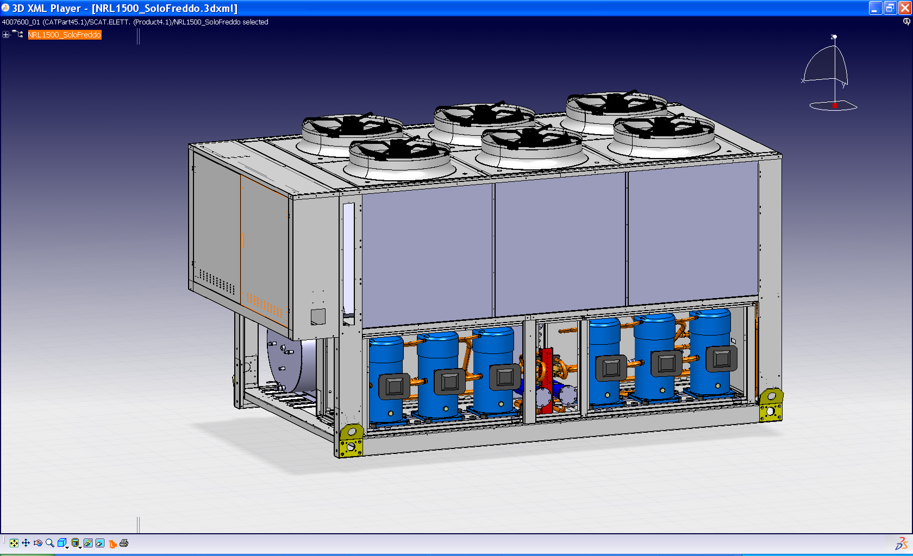
NRL: Heat Recovery Chillers
4
5
6
1
2
3
Circuit 1
Circuit 2

Slide 24
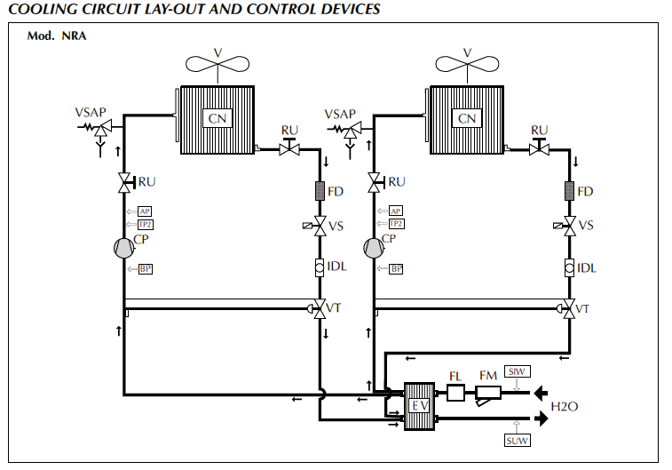
NRL: Heat Recovery Chillers
NRL Multiscroll with R410A

Slide 25
NRL: Heat Recovery Chillers
If the cooling load is dominant but there is also a heating load, why reject the heat outside?
Heat recovery options:
Desuperheater
Total heat recovery

Slide 26
NRL: Heat Recovery Chillers
Desuperheater is in series with the condenser
Only part of the condensation is done in the desuperheter
The rest is done in the external coils
Fan speed modulation is mandatory to control the heat pressure
Hot water up to 149°F
Typically heat recovery with a desuperheater is limited to 40% of the cooling capacity (depends on the criteria)

Slide 27
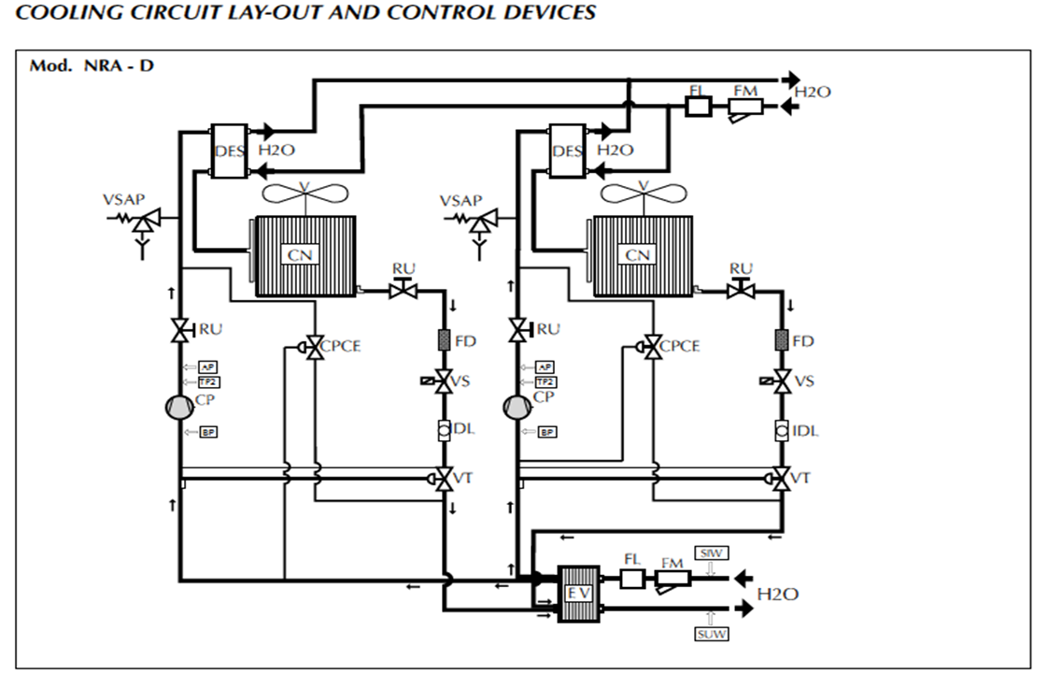
NRL: Heat Recovery Chillers

Slide 28
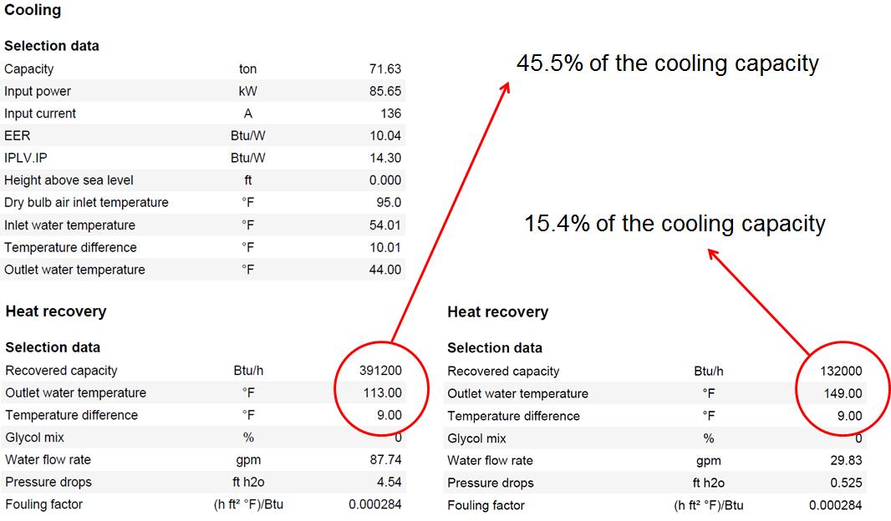
NRL: Heat Recovery Chillers

Slide 29

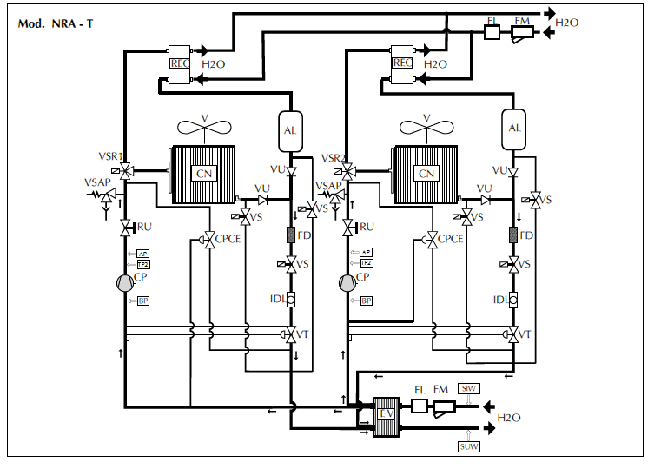

Total Heat Recovery

Slide 30
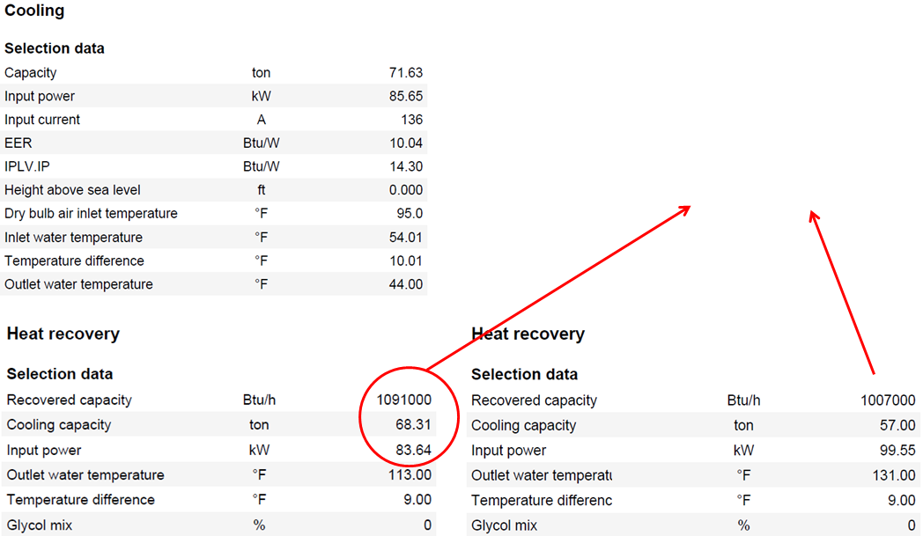
NRL: Heat Recovery Chillers
Global efficiency of 22.84 with
LCWT = 44F, and LHWT = 113F
Global efficiency of 16.99
with LCWT = 44F, and LHWT = 131F

Slide 31
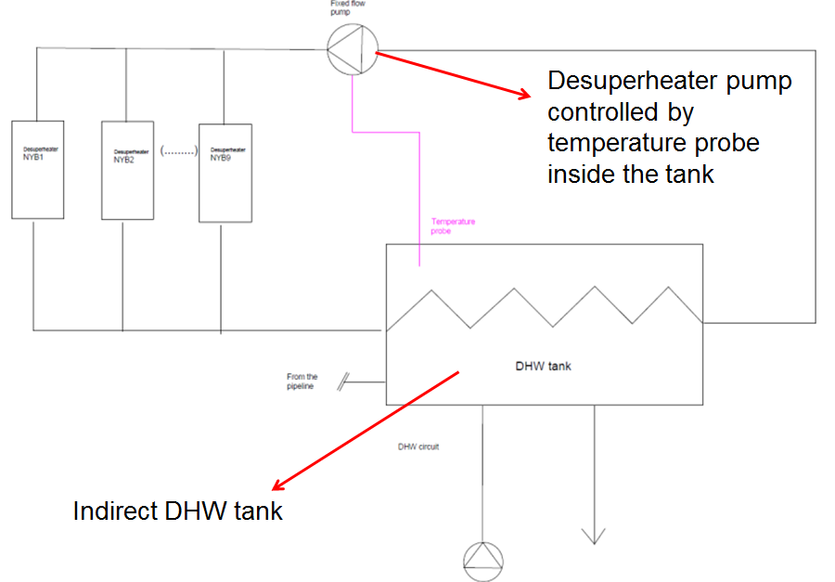
NRL: Heat Recovery Chillers

Slide 32
NRL: Heat Recovery Chillers
Recovery is activated when:
The unit is in cooling operation
There is a HW request
Recovery flow switch contact is closed
Minimum 3 minutes have passed since the CP started
Minimum 5 minutes have passed since previous switch to recovery mode
Recovery is de-activated once the recovery set point is satisfied

Slide 33
Section 2b:
Case Studies

Slide 34

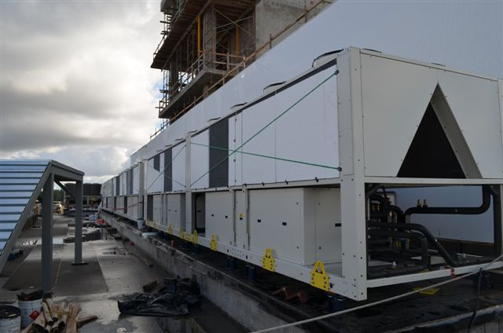
NRL Case Studies
Surrey Memorial Hospital
3 x NRL3600TA
Total Recovery Chillers

Slide 35

NRL Case Studies
TACC Heat Recovery Chillers
Two NRL1800**TA*I800
TACC Total Acute Care Hospital

Slide 36
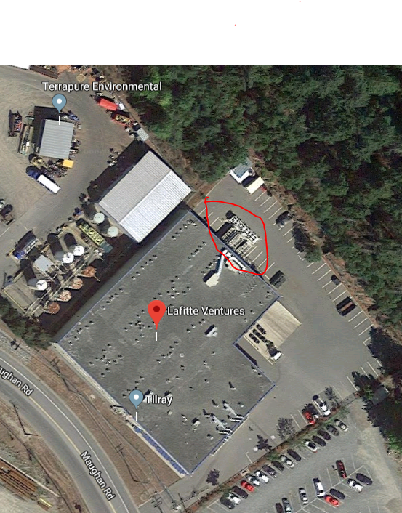


NRL Case Studies
NRL3600TA 100 Maughan Road BC
240 tons of cooling and 240 tons of free heat
Used for reheat and drying the Marijuana

Slide 37

NRL Case Studies
CFB Base Edmonton
NRL2800**TA*I8P2

Slide 38
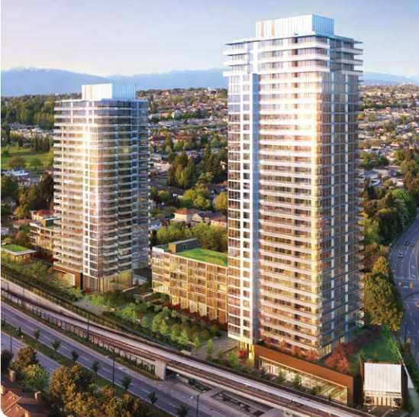

NRL Case Studies
Condominiums in Vancouver
4 x NRL1800HDA*I800

Slide 39
Thank you!
Notes:
make intro

